Slide 1
Integrating clinical data science and
systems biology
to deliver one transplant for life
immunology in motion ………..
fundamental … translation … clinical
Christian P. Larsen
Emory University School of Medicine
Notes:
Traditional research program now embracing and learning data science to harness the potential of access to unprecedented volumes of clinical and high-density, high through-put systems biology data
End user – learn, build relationships, thank and inspire
The challenge that we focus on
Our core purpose- improving outcomes of transplant recipients with ultimate goal of one transplant for life
]

Slide 2
my journey here
transplant surgeon, immunologist, translational and clinical researcher
An unplanned leadership trajectory Center Director, Surgeon-in-Chief, Dean , Physician Practice CEO
Multi-disciplinary model, lifelong care, system capabilities, ease of care delivery, data-driven decisions, 2000 formal learners! ~6,000 informal
Growing sense of distance from the real work
– caring, educating, discovering
Return to transplant surgery and science 2017

Slide 3
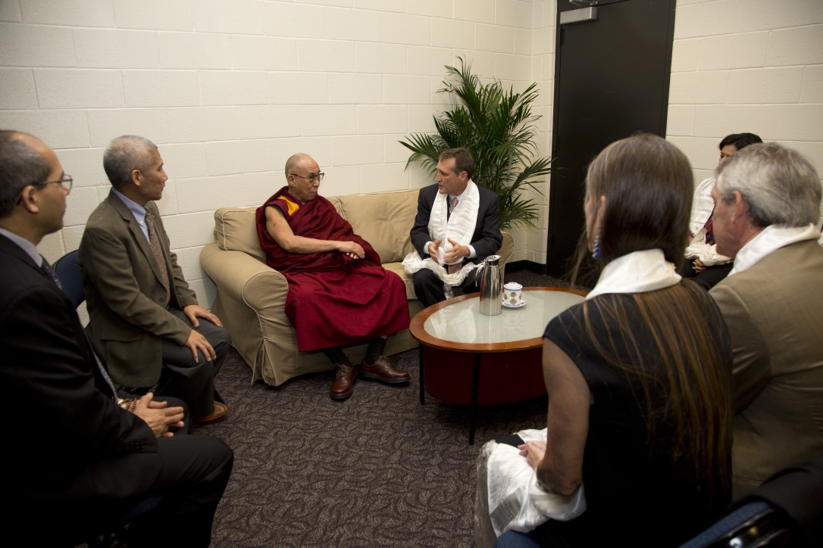
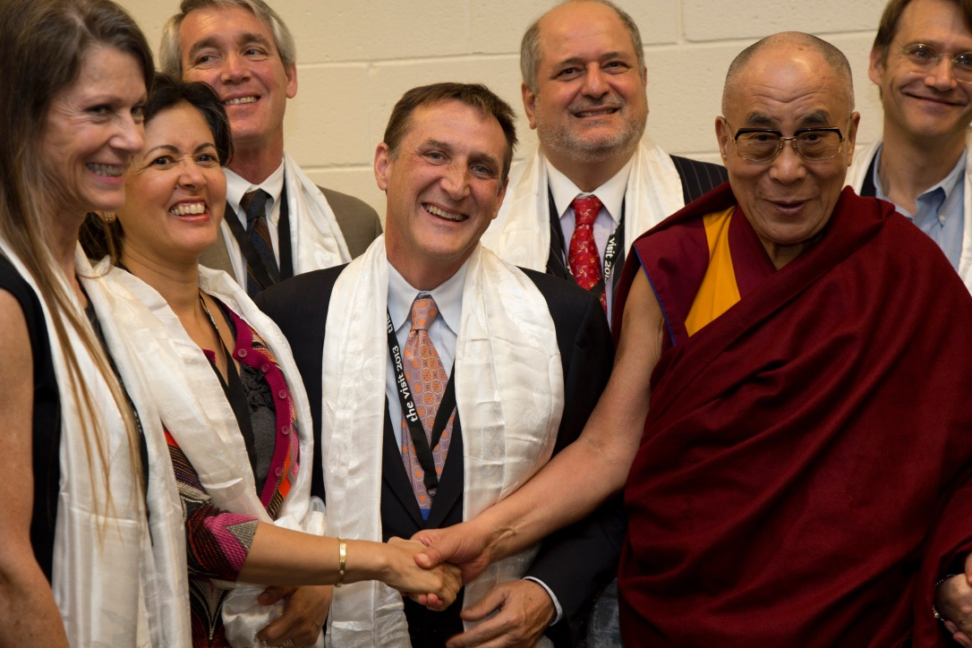
training in compassion developing resilience
introduce
engage
sustain

Slide 4
Context- Why we do what we do
Project 1 Virus (CMV) infection after transplant
Clinical Data Science
Project 2 Understanding protective immunity to CMV
Systems biology - Single cell immune profiling (multi-omics)
Building our team and ecosystem

Slide 5
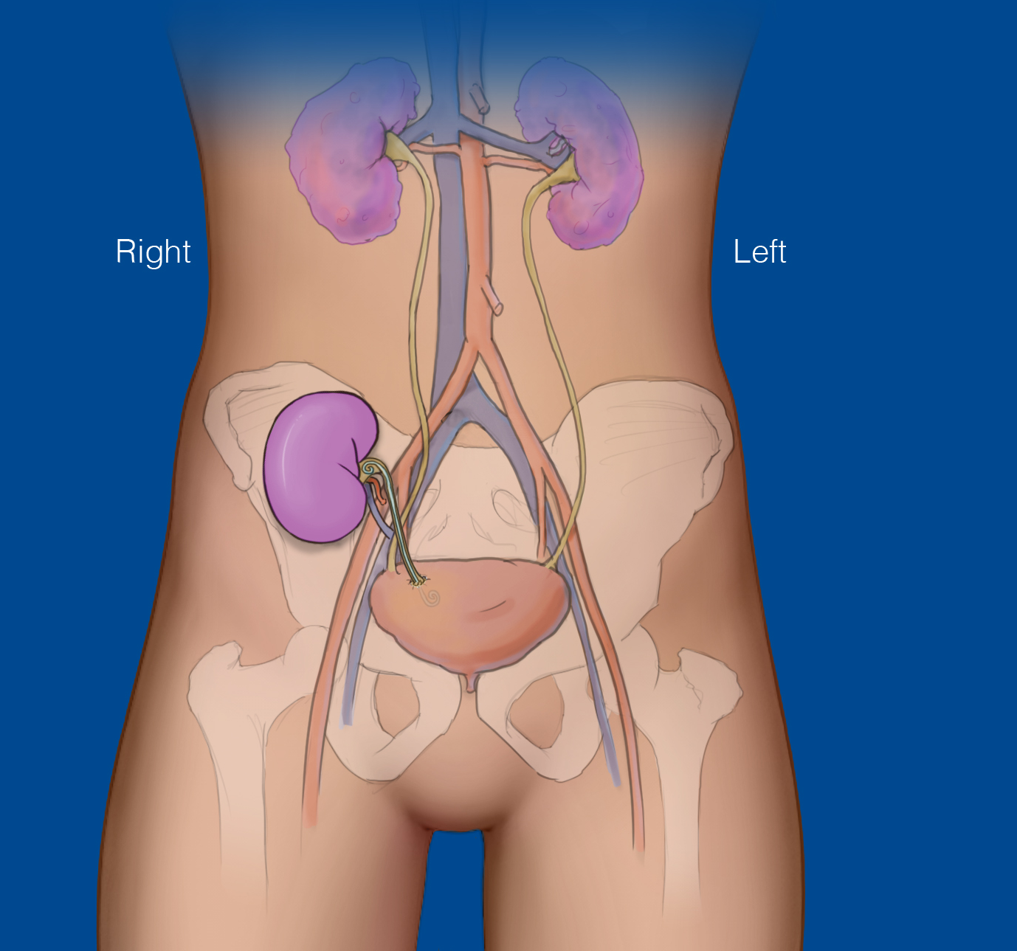
Kidney Transplantation 2019
~3 hour procedure
4 day hospital stay
1 year survival rates ~95%
>200,000 recipients alive with transplants
Notes:
Let me tell you a little bit about Kidney Transplantation
Goal not a transplant talk but a discussion of how we at Emory can transform care delivery- perfecting care delivery, innovation to advance what is possible – not antithetical but synergistic
Teach the least about transplant -
So what is the problem
opt

Slide 6
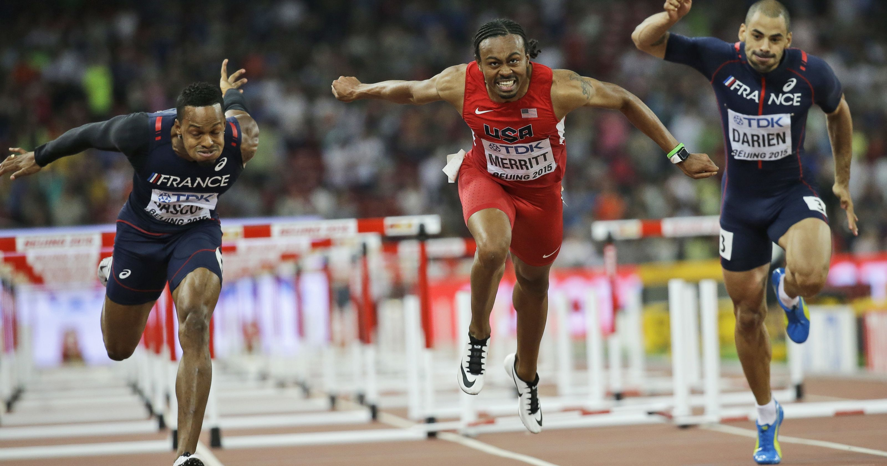
How many will last a lifetime?
Notes:
>200,000 , 30,000 organs
But sad fact
Unlikely he will have transplant for life with normal life span

Slide 7
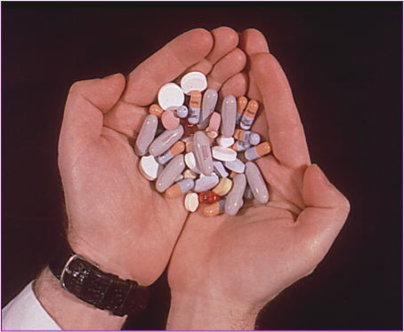
Transplant success depends on life-long multi-drug immunosuppressive regimens
Tacrolimus
8-12
5-8
Maintenance
Mycophenolate
Intensity of Exposure
Prednisone (5)
Induction
“Induction”
Time
Notes:
Let tell about a bit more about the challenge
For transplants to work patients need to adhere to life-long-multi-drug immunosuppressive regimens- In most cases they take three drugs for life.
Cornerstone are cyclosporin –type drugs
powerful lifelong multi-drug immunosuppressive regimens such as these. Virtually all renal transplant recipients on some variation of regimen shown here
Mainstay of are the calcineurin-inhibitors tacromilus and cyclo and for some sirolimus
While steroid use is decreasing majority of renal tx recipients in US are treated with steroids

Slide 8
Better Organs
Healthy Life Styles
Regimen Adherence
One Transplant for Life
Safer More Efficacious Immunosuppression
Prevent &
Treat Infection
Scientifically
Customized & Individualized Rx
Notes:
Achilles heal are drugs
Who need what?

Slide 9
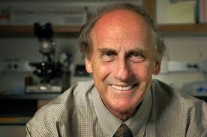
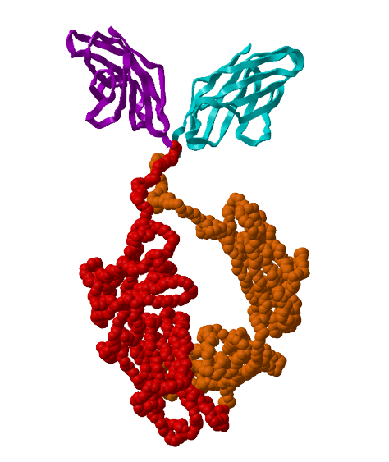
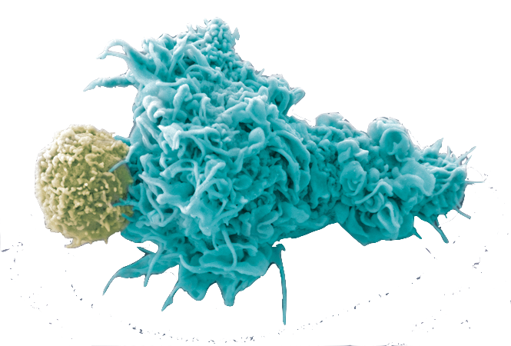
Belatacept Development:
Change
Practice
FDA Approval
Innovative Trial Design
Translational
Science
2011
Therapeutic
Concept
Phase II 2001
Phase III 2005
1992-1999
Unmet Needs
1987-90

Slide 10
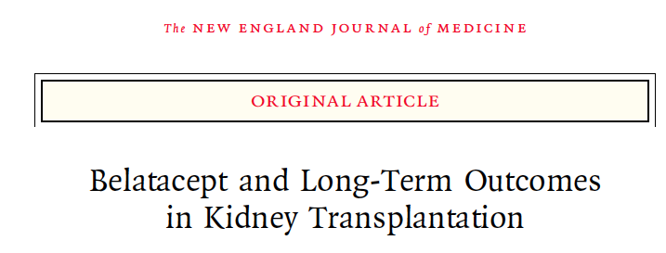
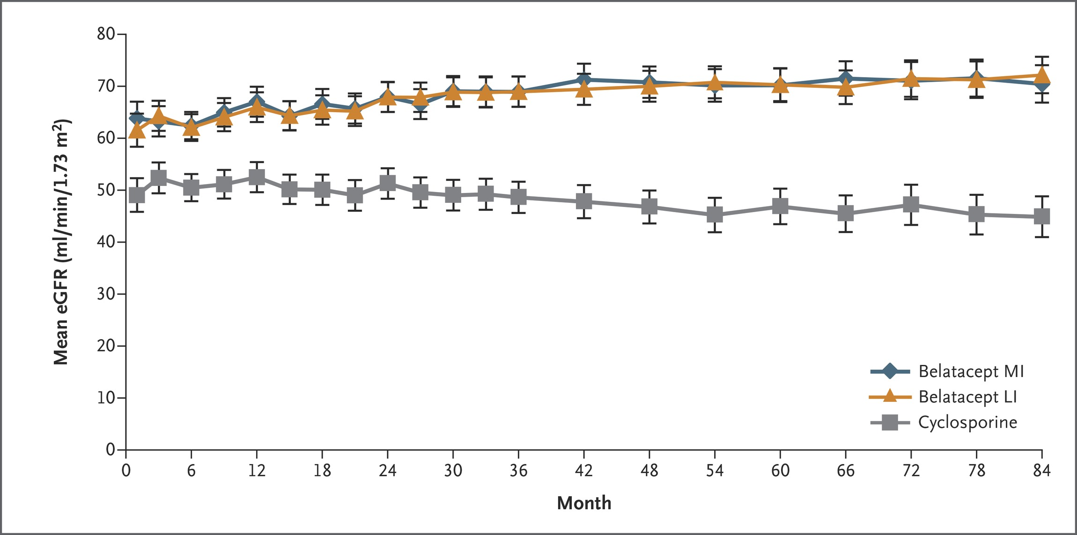
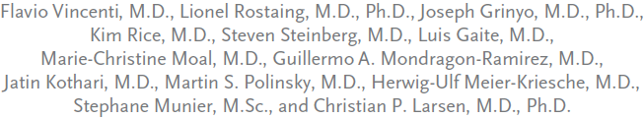
Superior Kidney Function (eGFR)
Pivotal Phase III: 7 Year Outcomes belatacept vs. cyclosporine
Superior Kidney Function - ~50+% eGFR
Improved Survival- 43% reduction in Death or Graft Loss
Issues
Minor signal of early acute rejection
Cannot be used for EBV negative recipients
Decreased Death or Graft Loss
Notes:
Adoption of Belatacept has led to improved kidney function, shown here. The Y axis is a measure of kidney function, and as you can appreciate, Belatacept based therapies preserve kidney function, while it is well appreciated that calcineurin inhibitors progressively cause scarring and fibrosis of the kidney. Additionally, there were similar improvements in cholesterol, blood pressure, and other parameters, leading to lower incidence of heart attack, stroke and diabetes. The hope is that due to these benefits, we will finally see an improvement in the long term outcomes of transplanted patients, that they will live for longer, with a healthy kidney.

Slide 11

Beginner's Mind: Journey back to transplantation and science
Sabbatical mindset:
Data science
Systems biology
‘-omics data and bioinformatics skills

Slide 12



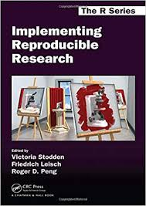




Embrace open source and a core tool set
Become fluent in the essentials
Build a team, a culture, and an ecosystem
Commit to reproducible research
the stakes are just too high
Notes:
Become fluent in the essentials
Docker
Pick and learn tools but stay nimble

Slide 13
Belatacept Development:
take a closer look
Change
Practice
FDA Approval
Innovative Trial Design
Translational
Science
2011
Therapeutic
Concept
Post-trial
Challenges
Rejection
Infection
Production gap
Phase II 2001
Phase III 2005
1992-1999
Unmet Needs
1987-90

Slide 14
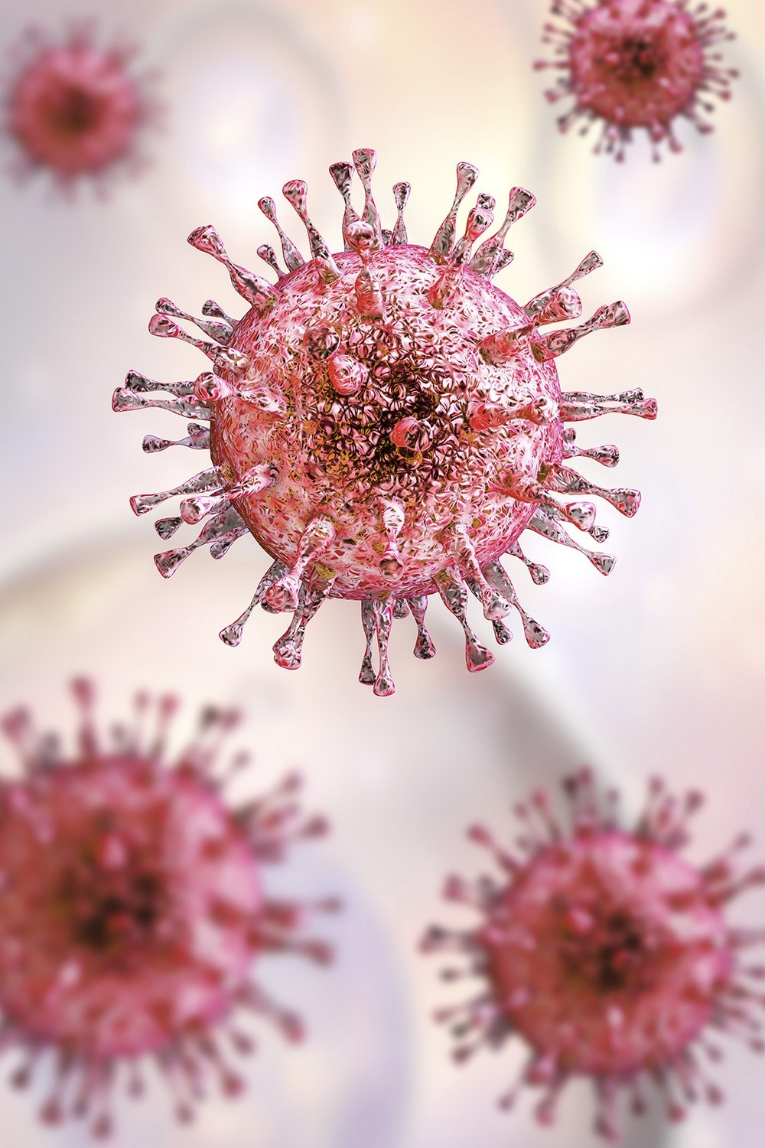
Cytomegalovirus
Latent in ~2/3 US transplant population
Major morbidity after transplant
Associated with rejection
CMV risk stratified by recipient and donor serostatus
CMV could pose unique problems for CMV high risk patients receiving belatacept

Slide 15
Questions
What is the impact of CMV risk status on survival outcomes of kidney transplant recipients at Emory?
patient survival, graft survival, composite death or graft loss
What is the impact of belatacept on survival outcomes in CMV high-risk subjects?
What is the impact of belatacept on patterns of viremia in CMV high-risk subjects?

Slide 16


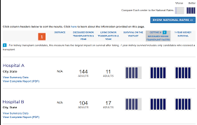
Transplantation a data rich field
Emory Transplant Center
Information workflows & Datamart 2005-
Staging
REDCap
Laboratory Information Management System (LIMS)
Clinical Data Warehouse
Tissue Typing
Legacy Data
US Organ Transplant Data 1988-
Mandatory reporting
Risk Adjusted Program Specific Reports
Program accreditation & CMS payment
Care
Quality
Operations
Research
Strategy
Transplant Data Mart
Notes:
Marc Overcash, Jeff Weaver, Kendra Little
Timeline: TDM was envisioned ~ 2010, construction began 2012, first report published 2013
Team members:
Then = 2 technical leads (healthcare/university), ETL analyst, business/data analyst, DBA, PM
Now = business/data analyst, ETL analyst
Priorities/business rules managed by multidisciplinary governance group (Epi, ID, Surgeons, Physicians)

Slide 17
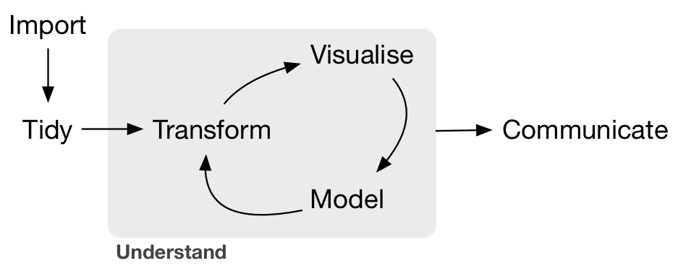
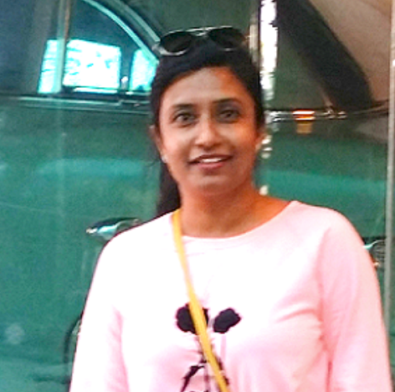
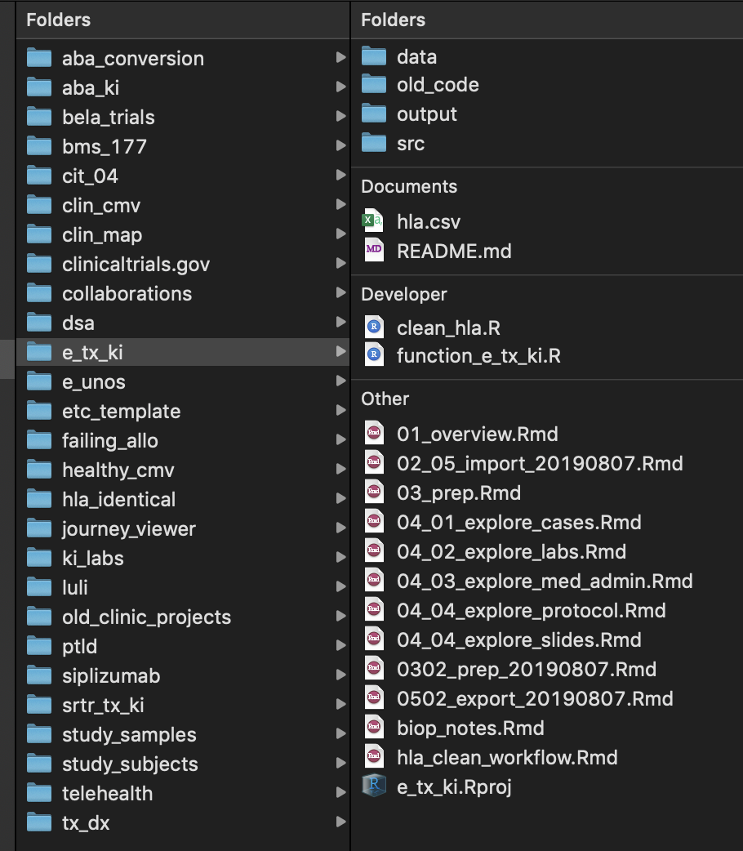
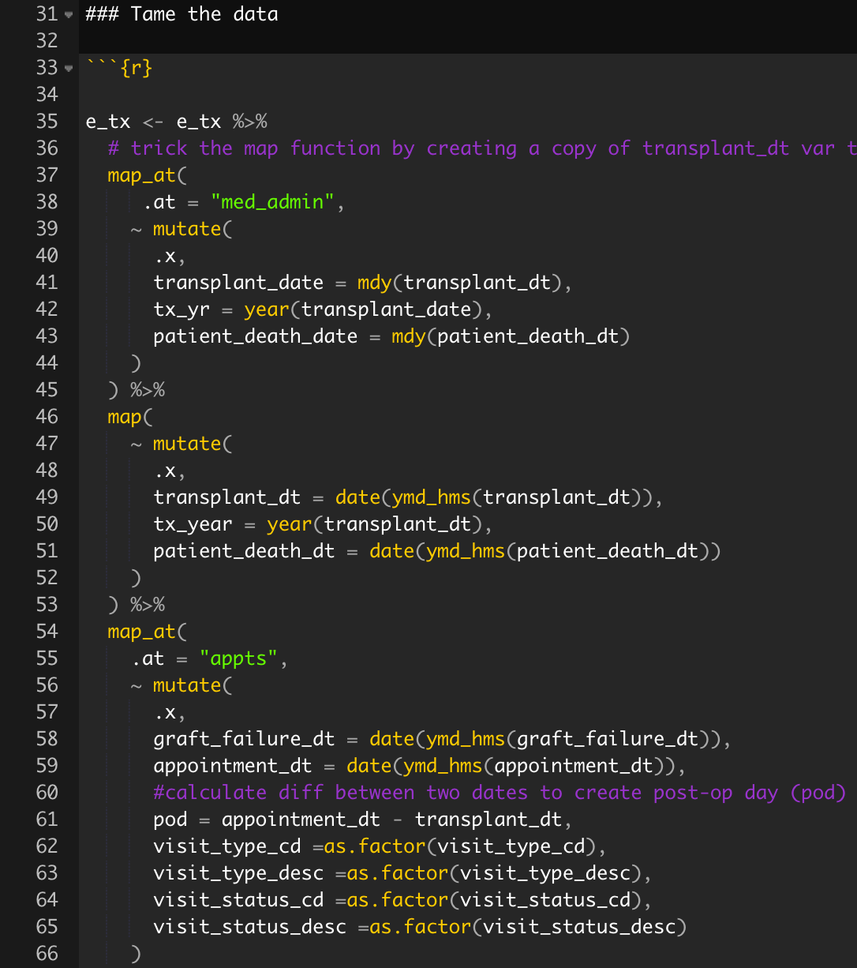
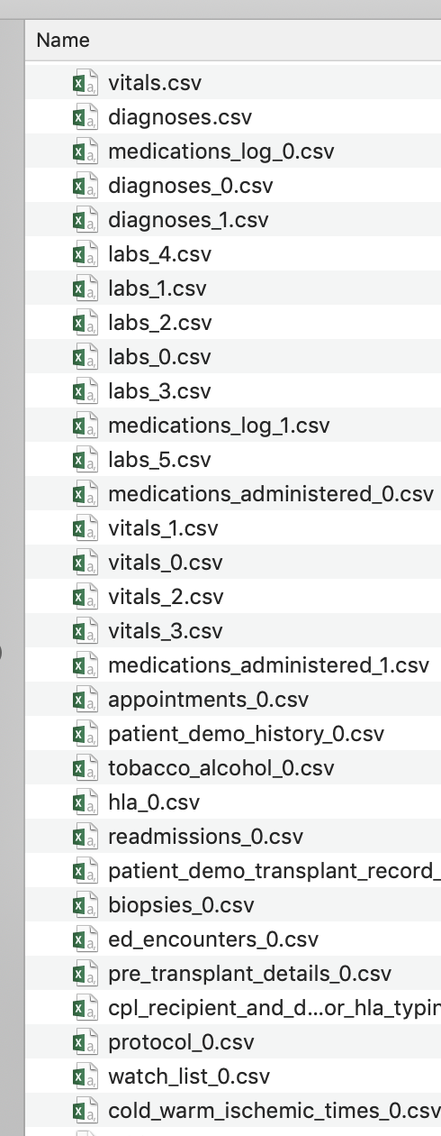
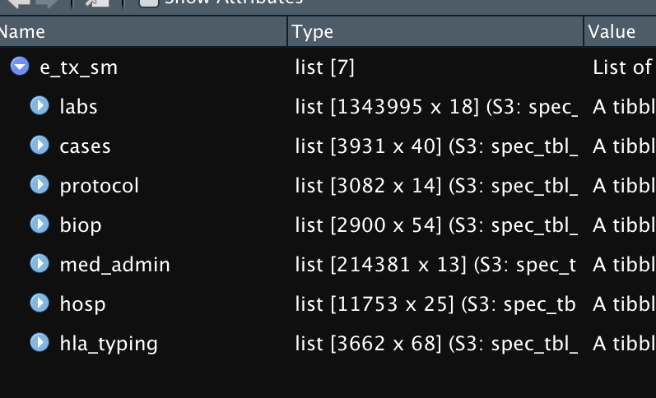
Inspired by Rmedicine 2018 a problem in hand- we can do this
Geeta
Karadkhele
Transplant Data Mart
tidy-transform
parameterized
automated
18 linked csv’s
>50,000,000 rows
~350 variables
readr
tidyr
dplyr
lubridate
purrr
Project Ready
monthly
linked list of dfs
“sm_tidy_dt.rds”
Notes:
Marc Overcash, Jeff Weaver, Kendra Little
Timeline: TDM was envisioned ~ 2010, construction began 2012, first report published 2013
Team members:
Then = 2 technical leads (healthcare/university), ETL analyst, business/data analyst, DBA, PM
Now = business/data analyst, ETL analyst
Priorities/business rules managed by multidisciplinary governance group (Epi, ID, Surgeons, Physicians)

Slide 18
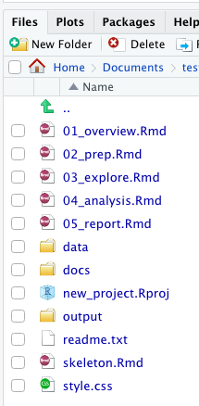
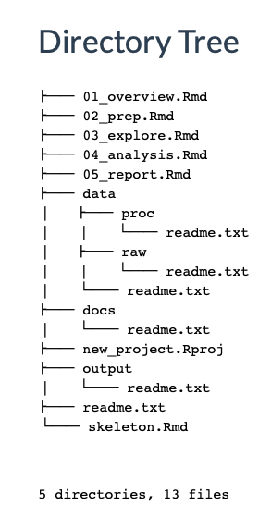
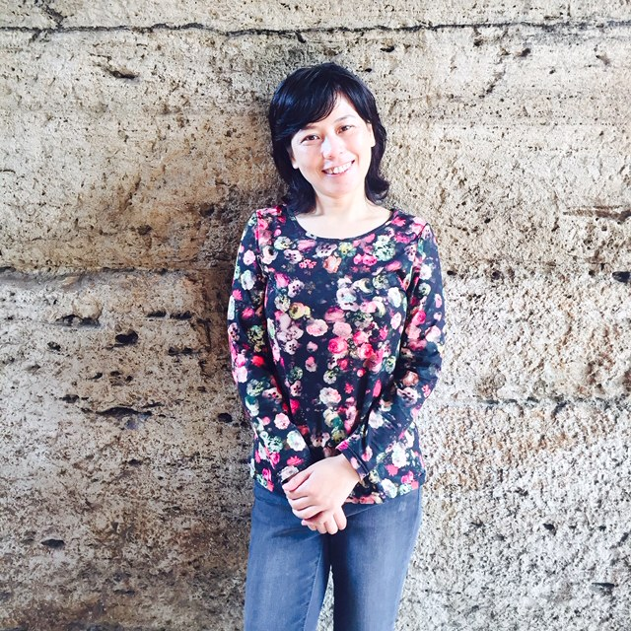
ezsetup:: – reproducible project set up
> library(ezsetup)
> setRproj("~/Documents/new_proj")
Joan Zhang

Slide 19
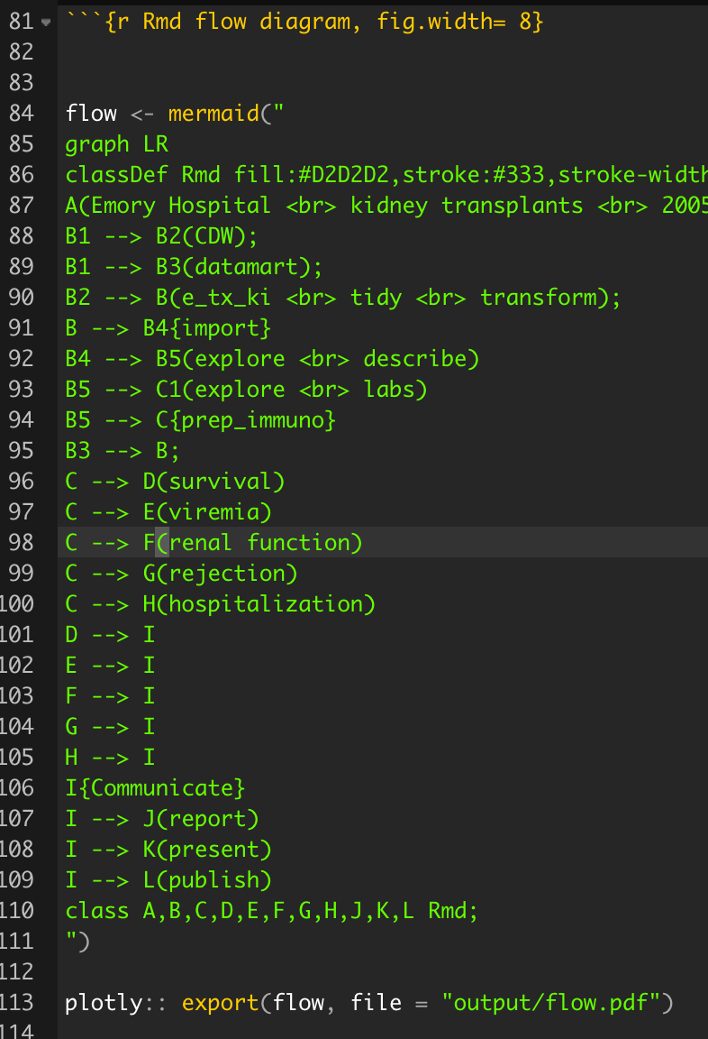
ezsetup – reproducible project set up

Slide 20
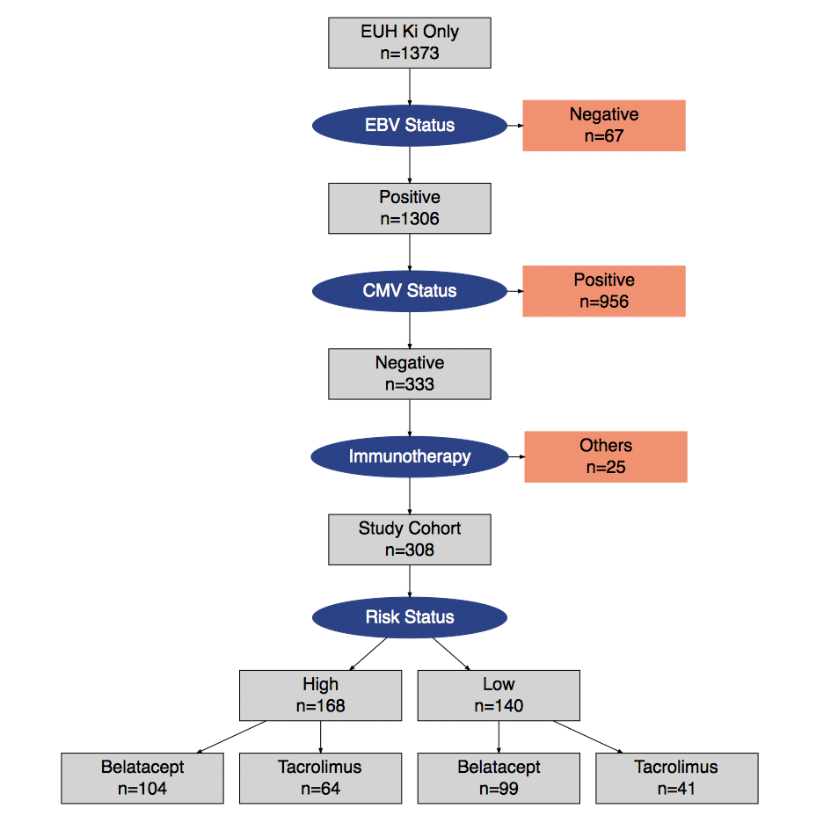
Emory CMV high risk kidney transplant cohort
Emory Hospital
Kidney Transplants only
Transplanted 2005 - 2018
First Transplant
168 CMV High Risk
Code filled
Notes:
GMK: next we assess our local data at Emory Hosp. In the left panel, we have our inclusion criteria and we included only the patients with primary kidney transplant and who were operated in Emory and between the period of 2005-2018 and were adults at the time of transplant.
In the right panel we have our study flow diagram for Emory. The Emory cohort included ~3843 patients and we narrowed it down by filtering it on the earlier mentioned inclusion criteria. here our primary focus was on cmv neg recipients particularly of high risk population whether they received bela or tac.So final study population is 339 cmv negative kidney transplant patients, of which 208 received belatacept and 106 received tacrolimus.

Slide 21
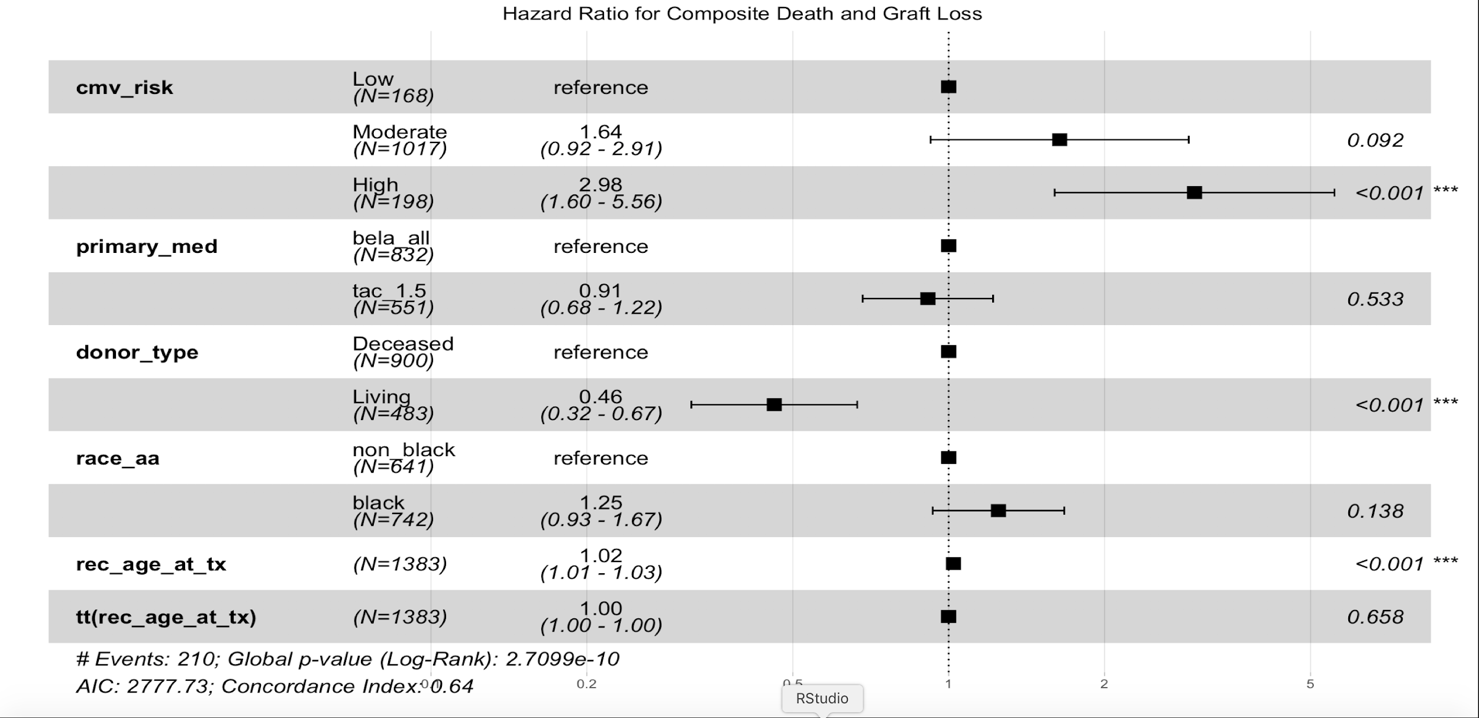
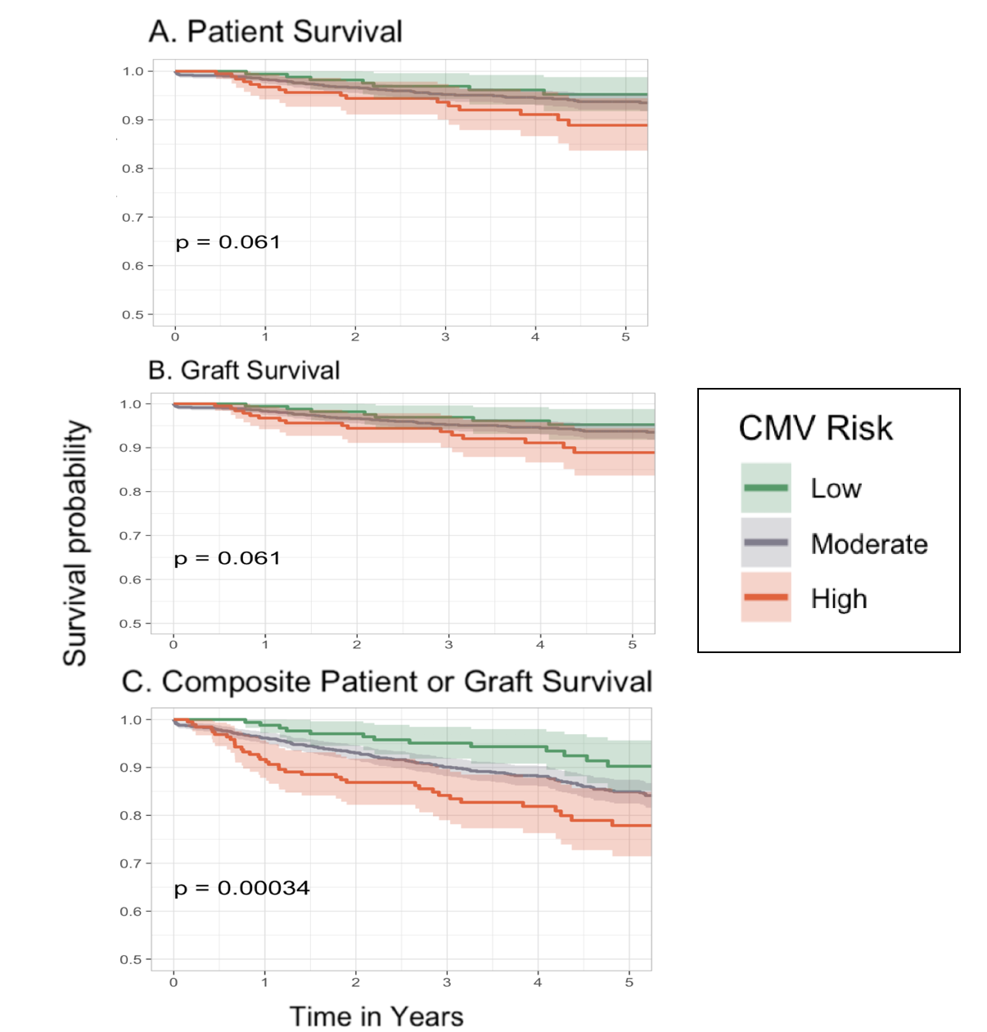
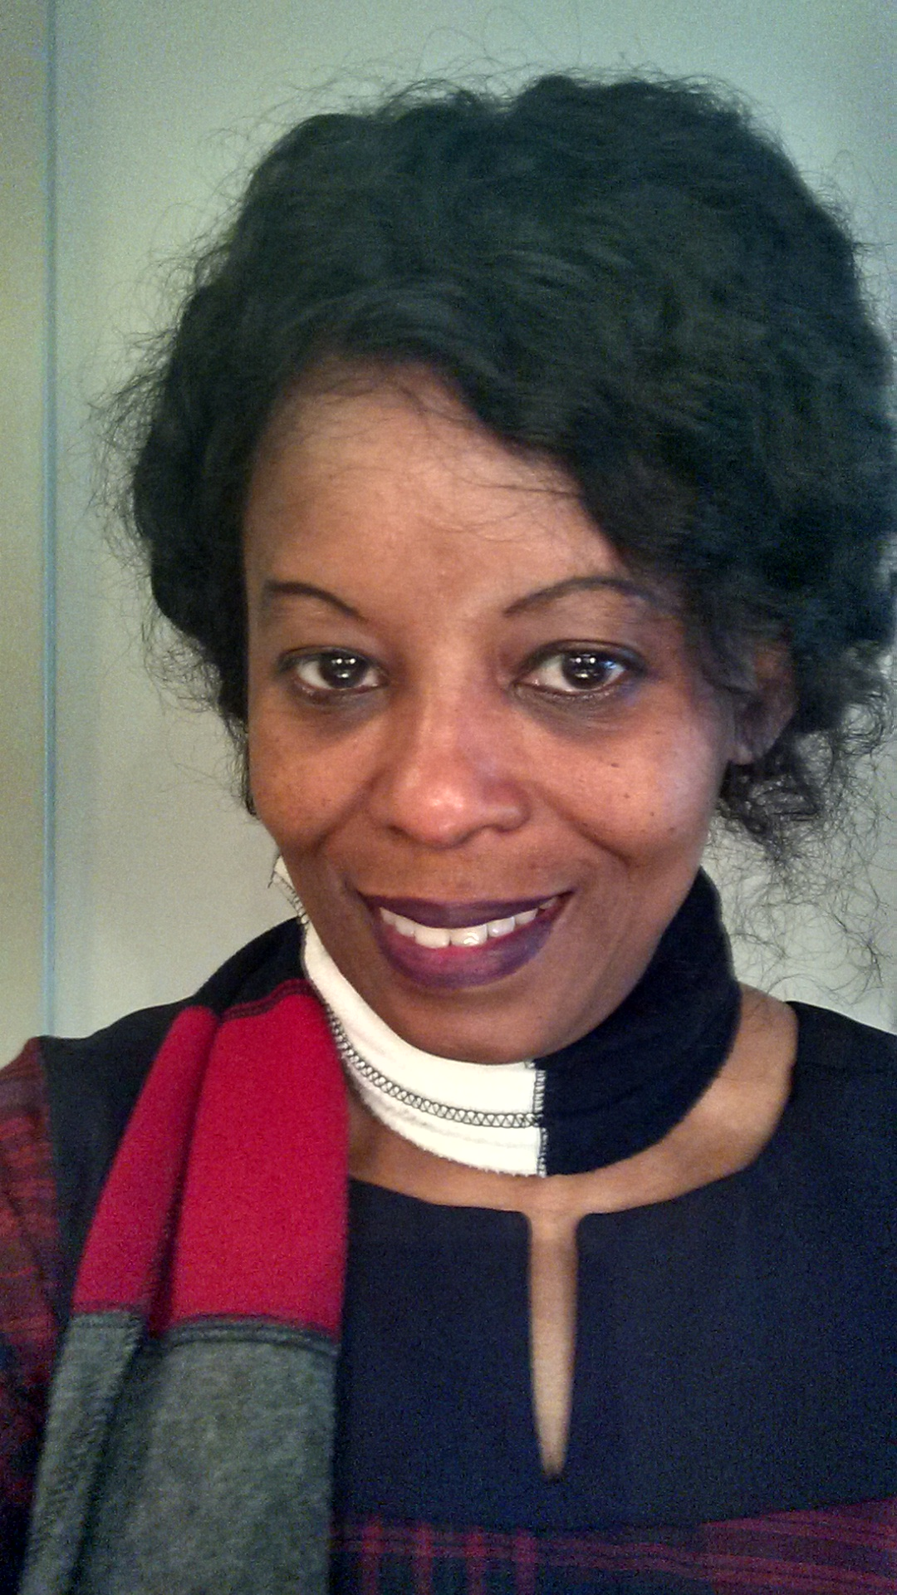
CMV high risk status is associated with inferior transplant survival outcomes
readr
tidyr
dplyr
survival
survminer
KM
Cox
Geeta
Karadkhele
Wairimu
Magua

Slide 22
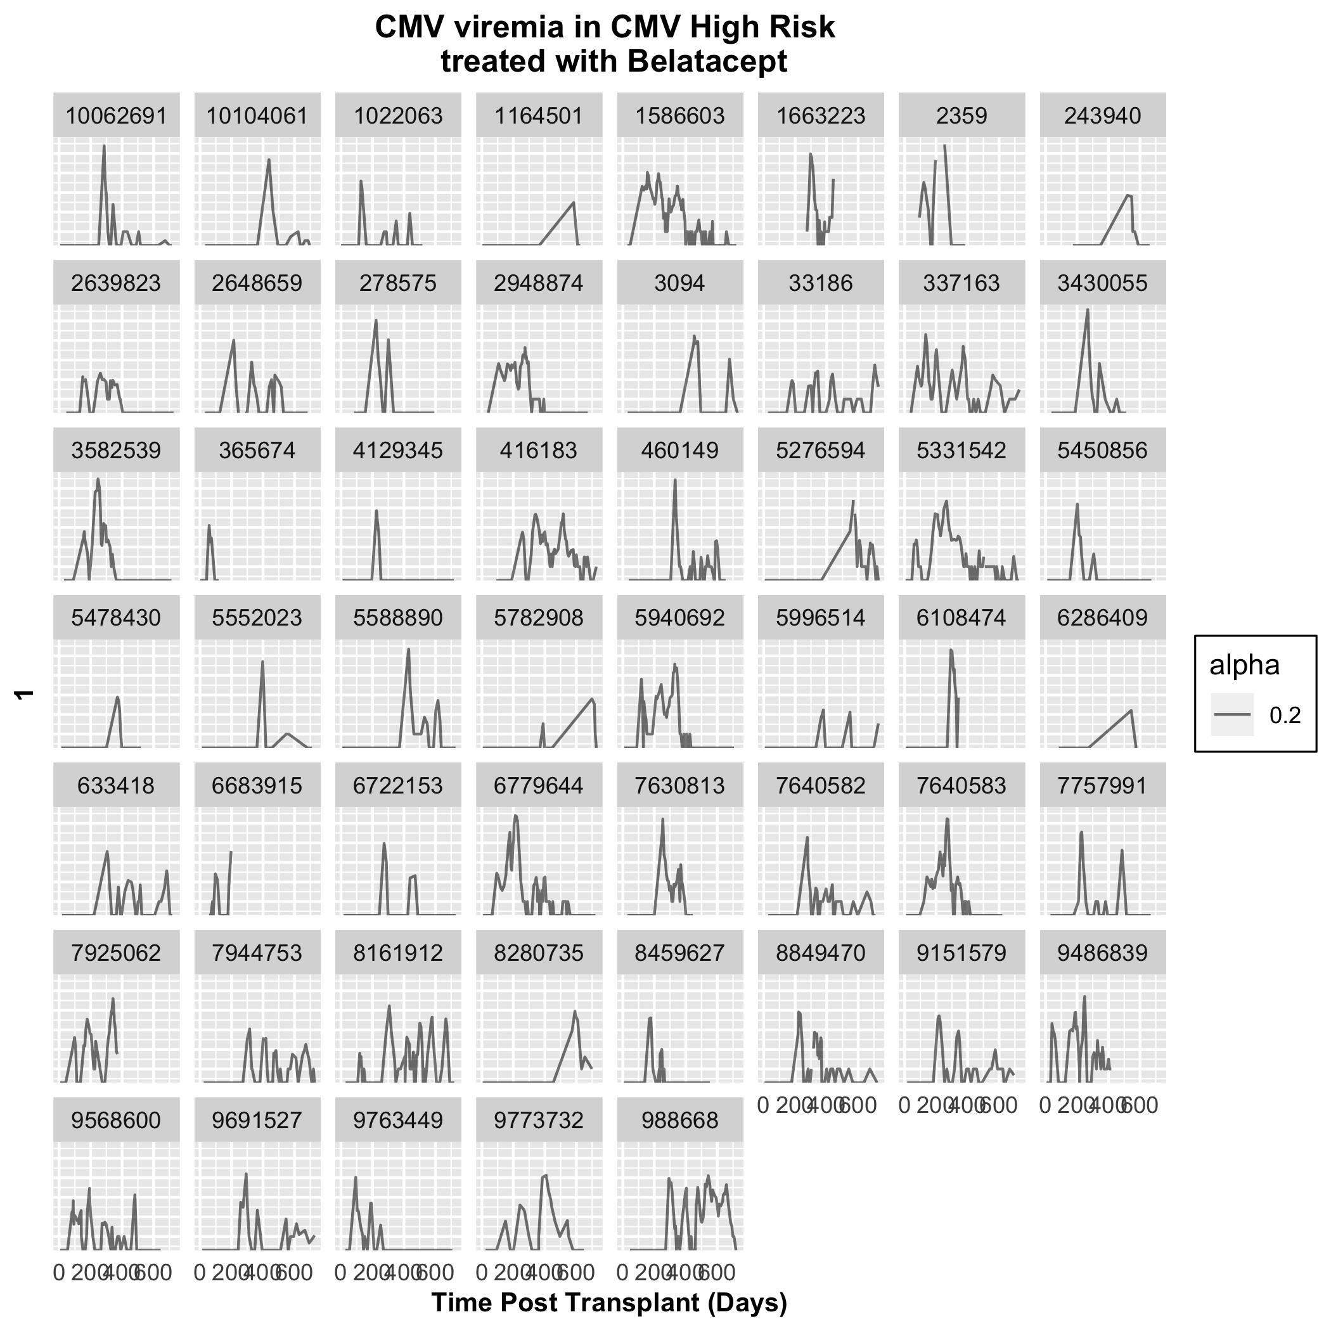
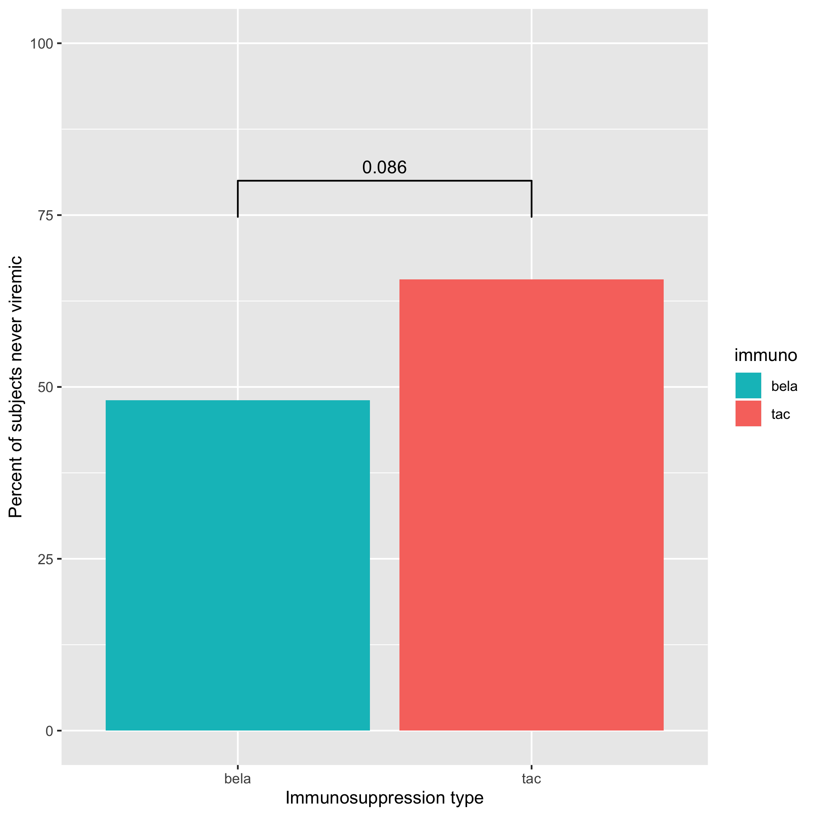
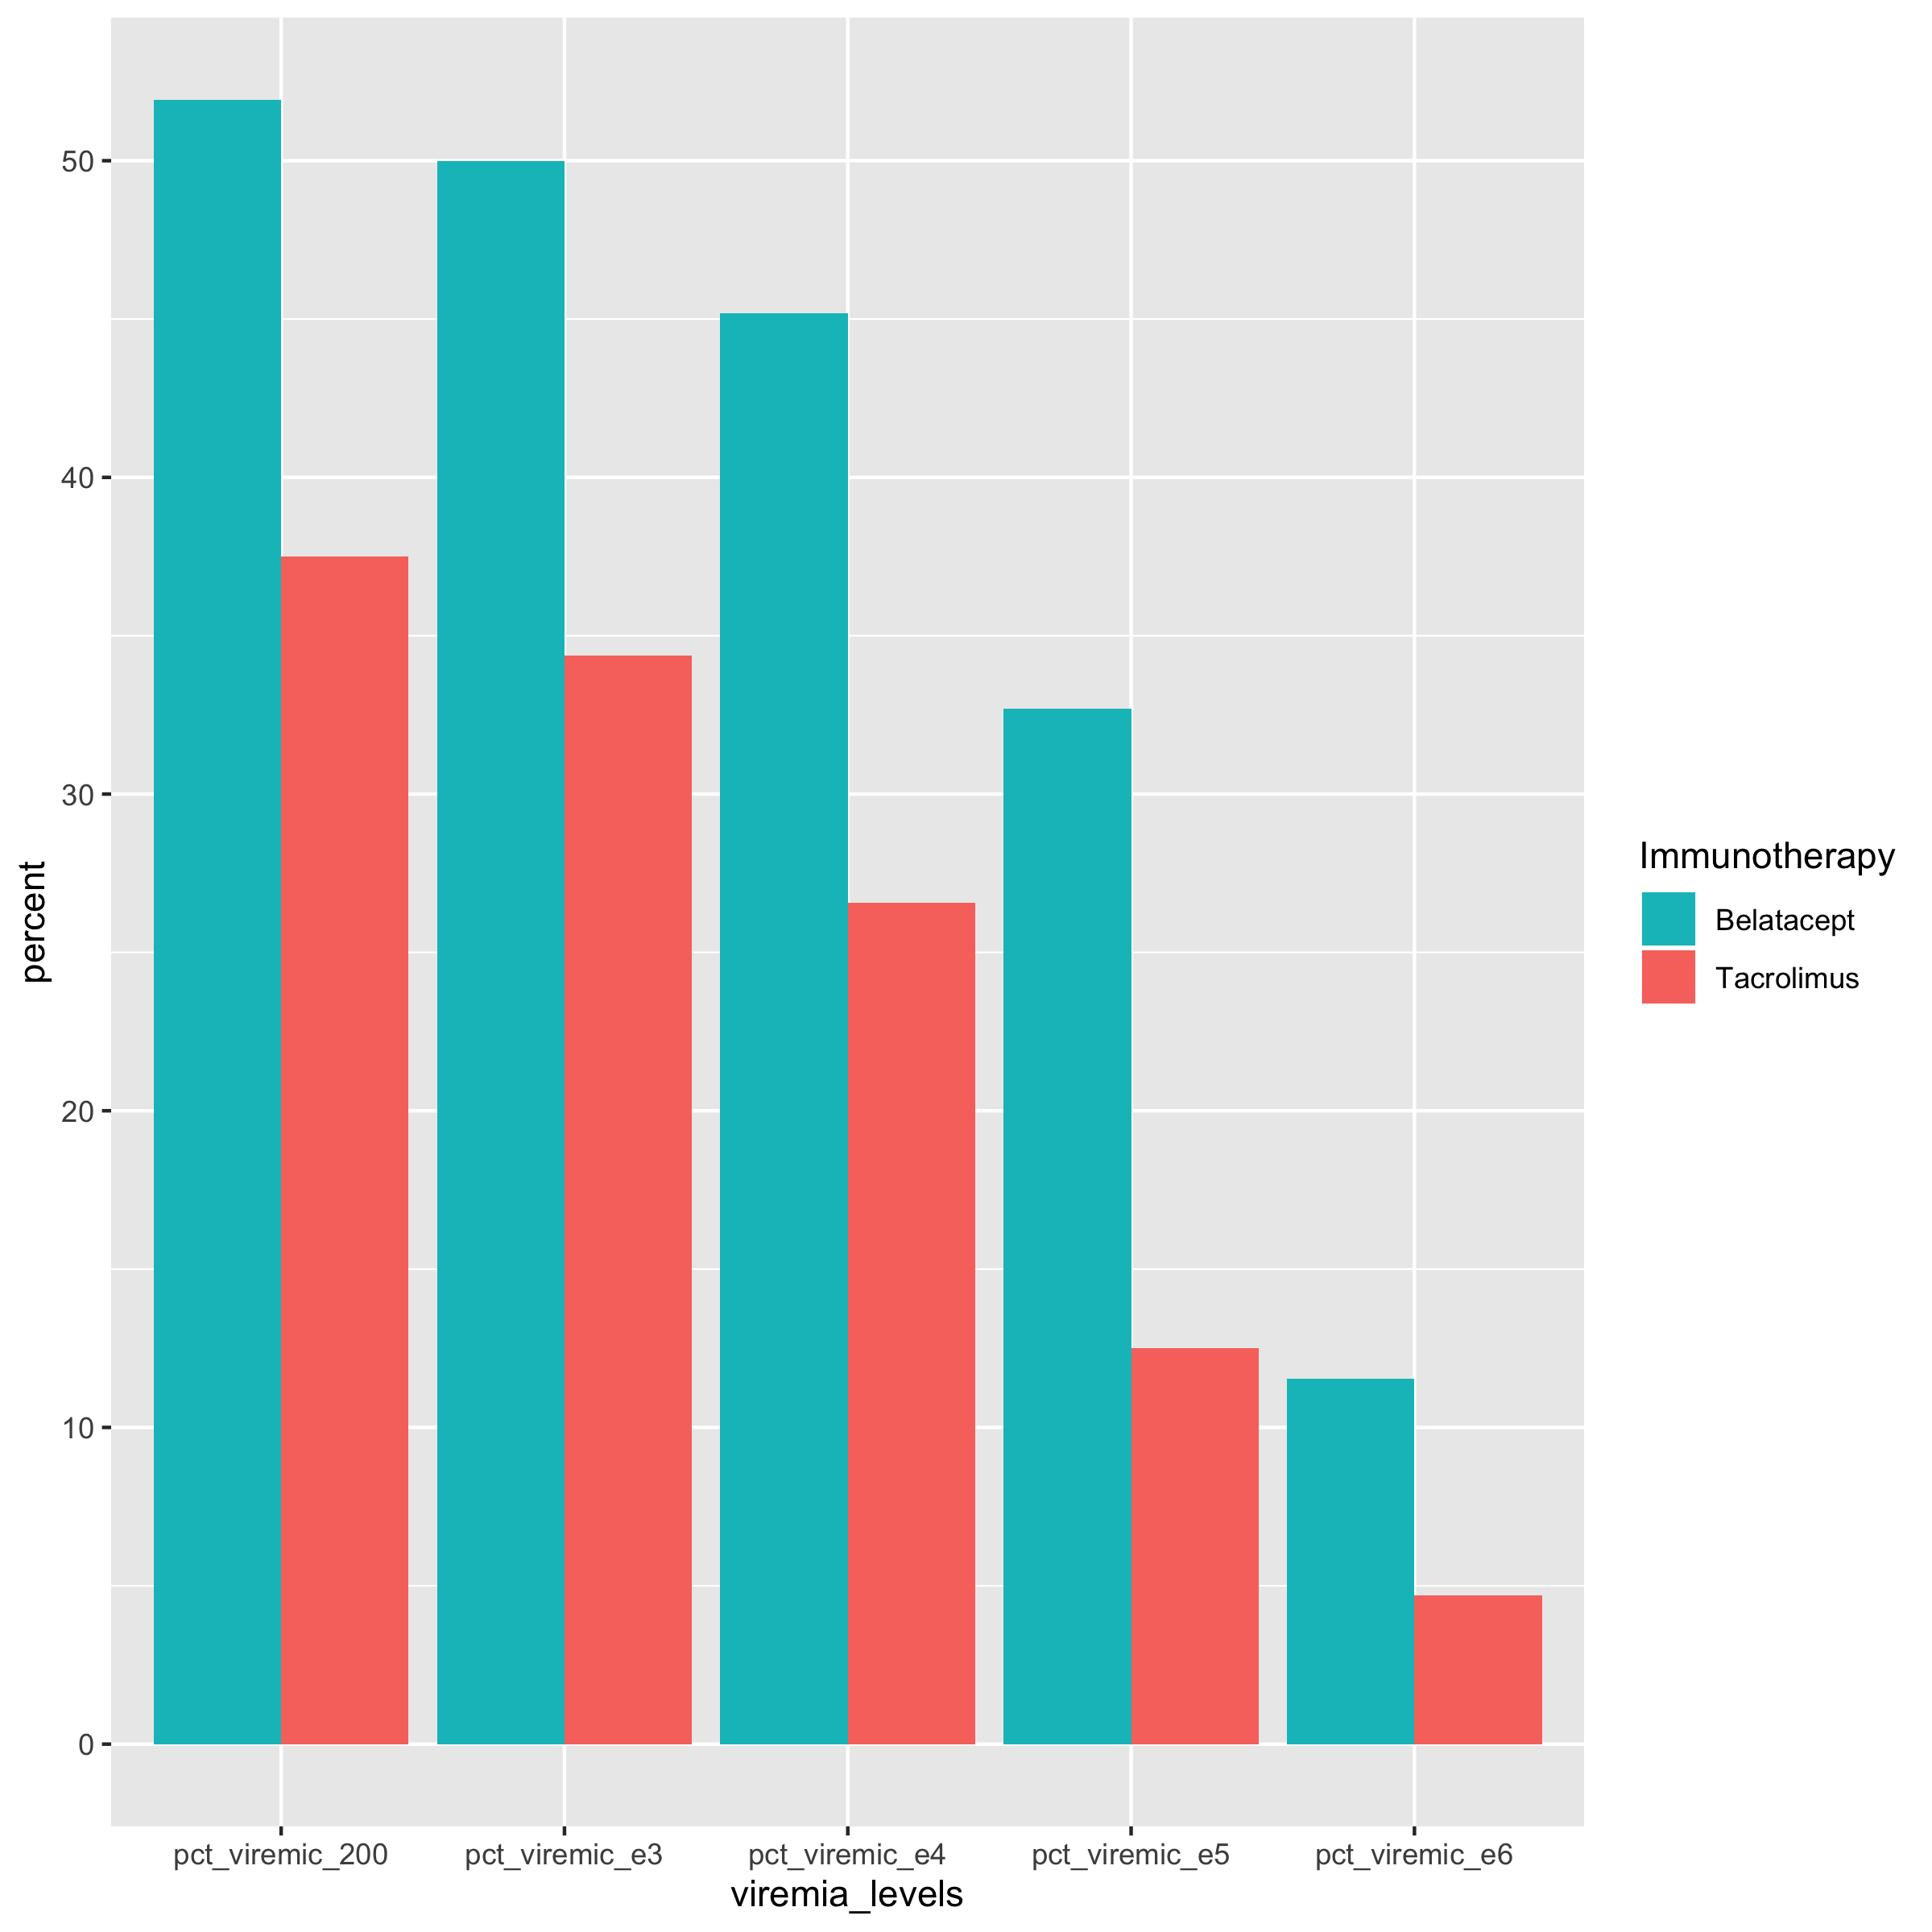
Belatacept – associated with higher incidence and burden of viremia in CMV high risk recipients (15% of population)
Freedom from viremia
Incidence of Viremia
Peak viral load
Area under the curve
Duration of viremia
Proportion viremic
by log load

Slide 23
Context- Why we do what we do
Project 1 Virus (CMV) infection after transplant
Clinical data science
Data-driven change in practice (monitoring and immunosuppression)
Project 2 Understanding protective immunity to CMV
Systems biology - Single cell immune profiling (multi-omics)
Building our team and ecosystem

Slide 24
Context- Why we do what we do
Project 1 Virus (CMV) infection after transplant
Clinical Data Science
Project 2 Understanding protective immunity to CMV
Systems biology - Single cell immune profiling (multi-omics)
Building our team and ecosystem

Slide 25
Cytomegalovirus
Latent in ~2/3 US transplant population
Major morbidity after transplant
CMV could pose unique problems for patients receiving belatacept
Aim 1: Assess impact of CMV risk status and CMV viremia on patient survival, transplant failure, patterns of viremia, and rejection in kidney transplant recipients receiving tacrolimus and belatacept based regimens
Aim 2: Assess impact of CMV exposure history and CMV risk status on human immune system phenotype and function in healthy humans and transplant recipients using high dimensional flow cytometry and single cell transcriptomics, and shot-gun metagenomics

Slide 26
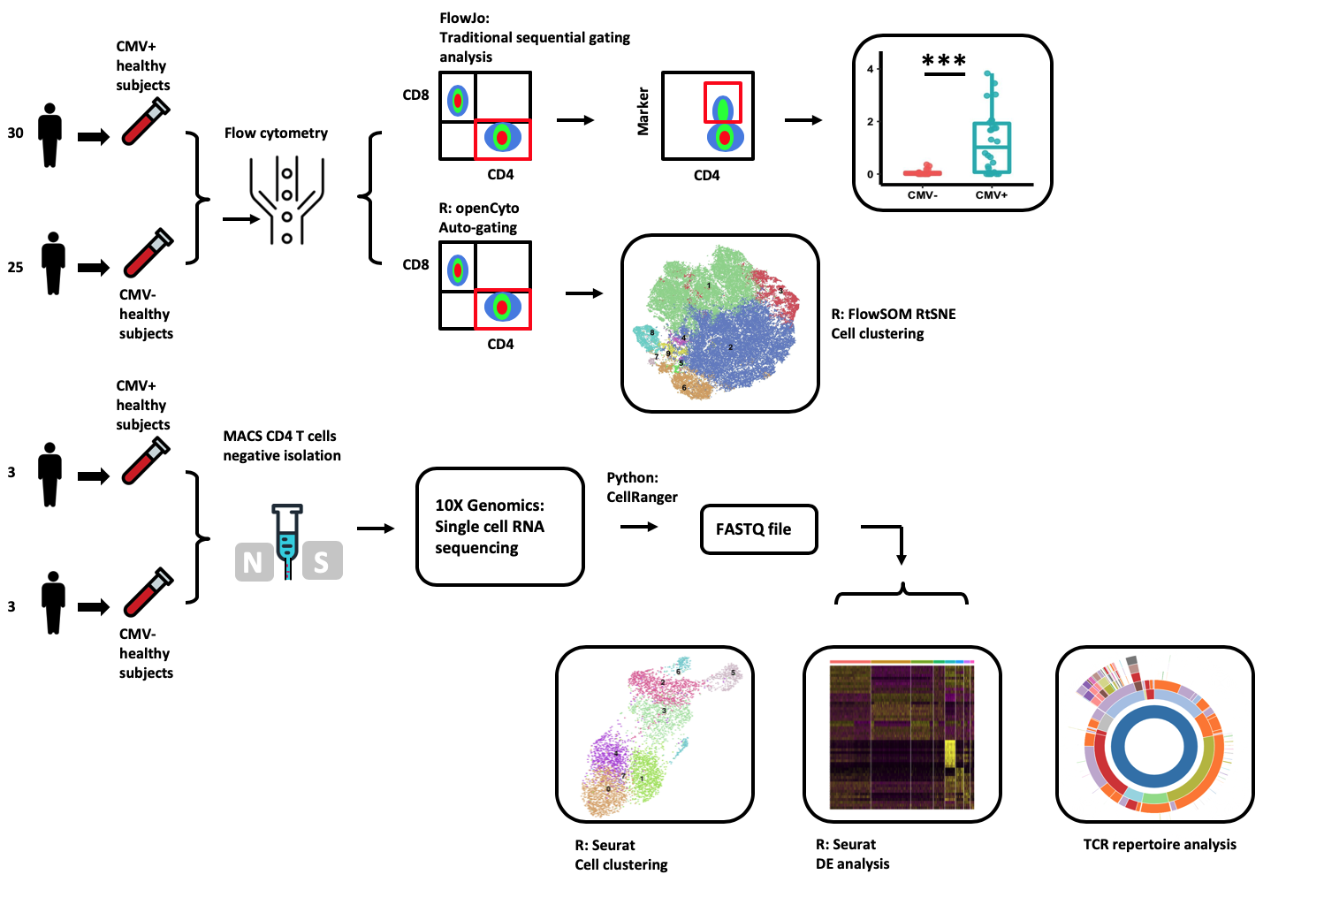
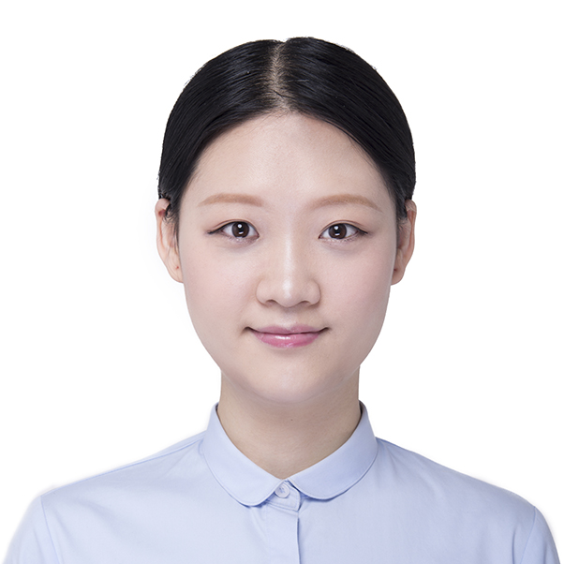
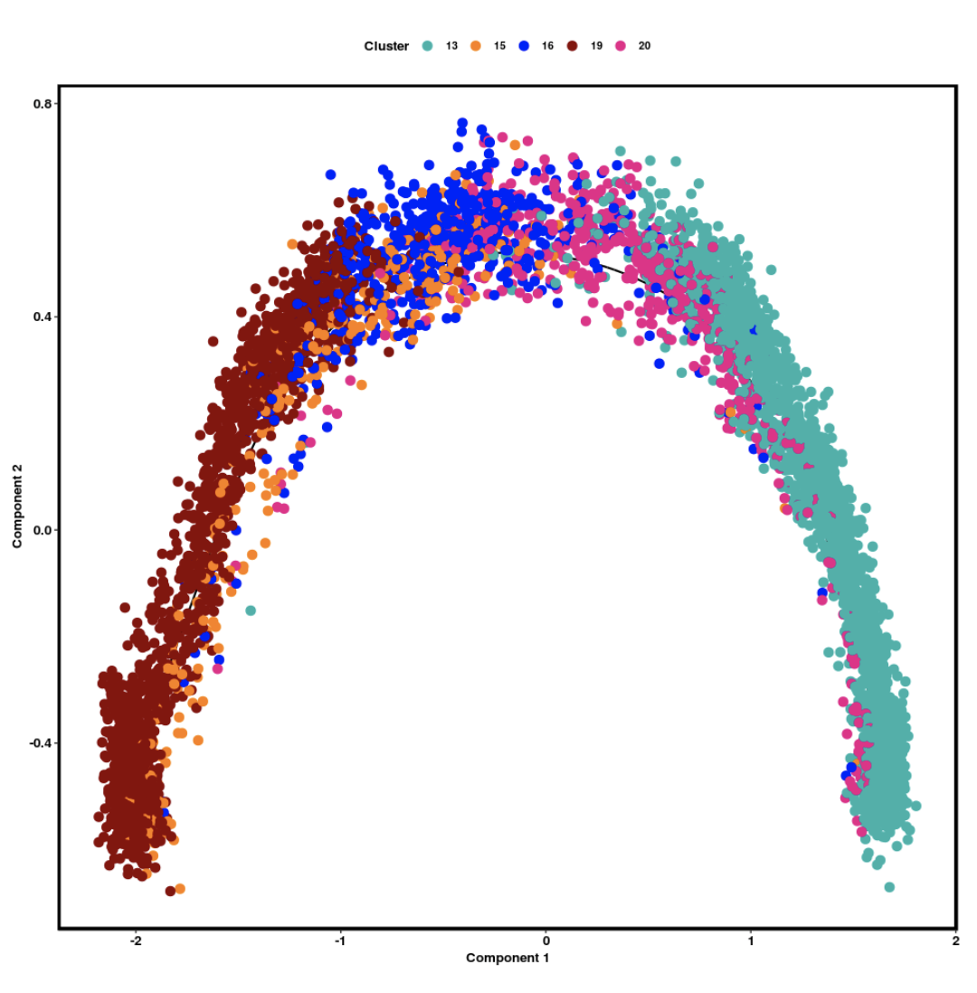
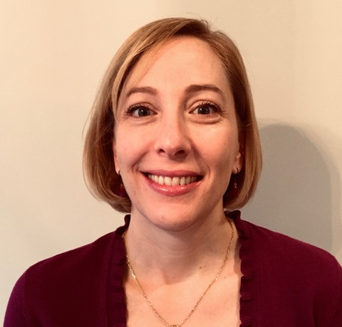
Reproducible research methods for flow cytometry and single cell -omics of blood lymphocytes
Weiwen Zhang
Jennifer Robertson

Slide 27
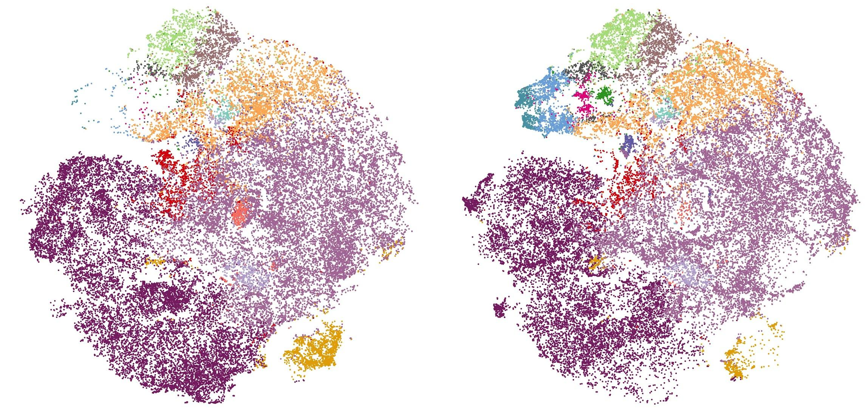
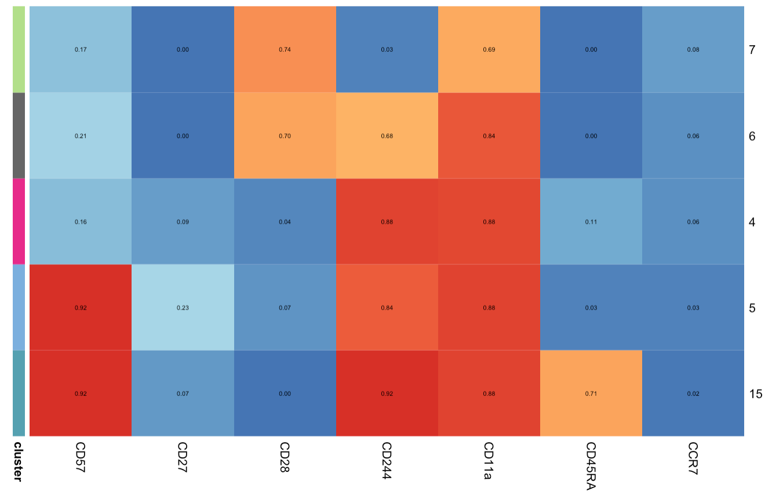
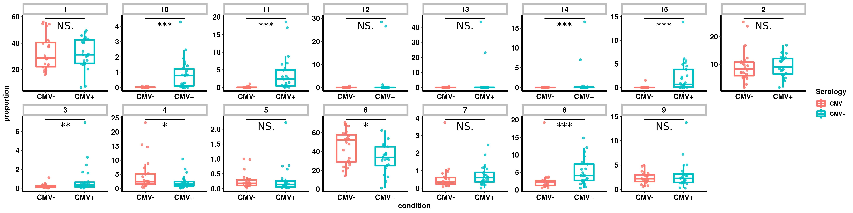
Unsupervised clustering defines phenotypically distinct CD4 T cell populations in CMV + Subjects
7
5
6
Population Discovery
Visual Exploration
Differential Abundance
Phenotype discovery
With reproducible analytic code!
15
4
CMV -
CMV +
CD57 CD27 CD28 CD244. CD11a CD45RA CCCR7

Slide 28
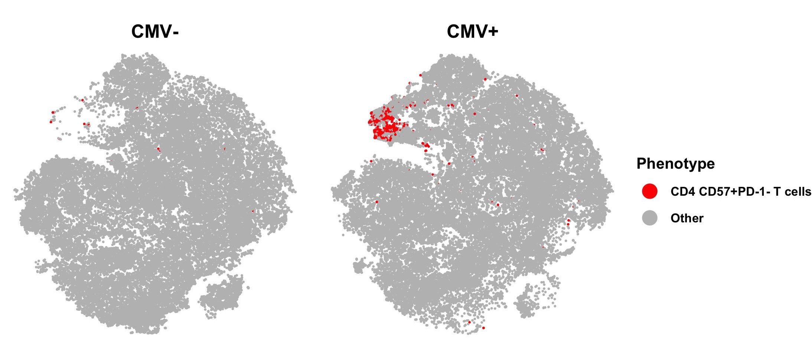
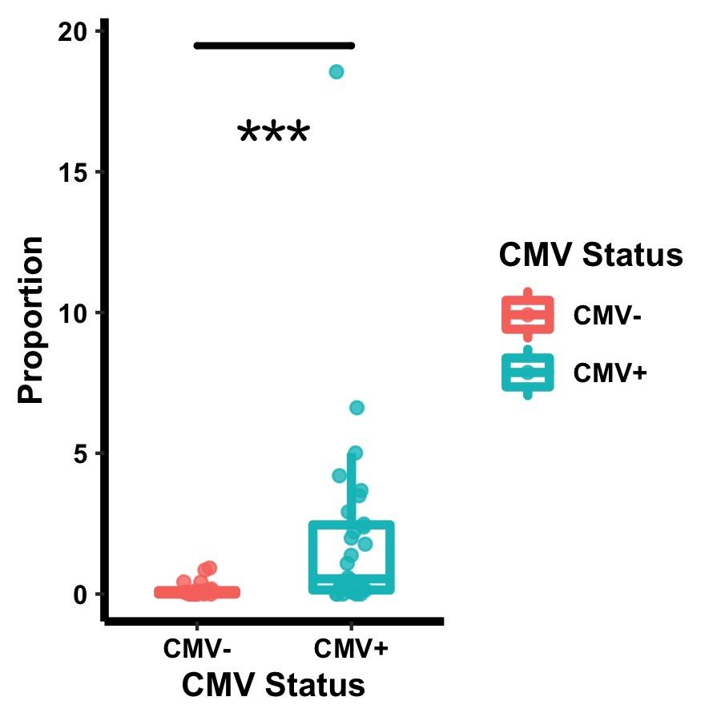
A rejection T cell candidate biomarker is associated with CMV exposure
tSNE2
tSNE1
Notes:
We found that those cells exist within cluster 5 and 15 and are significantly increased in CMV+ healthy subjects

Slide 29
Context- Why we do what we do
Project 1 Virus (CMV) infection after transplant
Clinical Data Science
Project 2 Understanding protective immunity to CMV
Systems biology - Single cell immune profiling (multi-omics)
New insight, new therapeutic targets, new hypotheses
Building our team and ecosystem

Slide 30
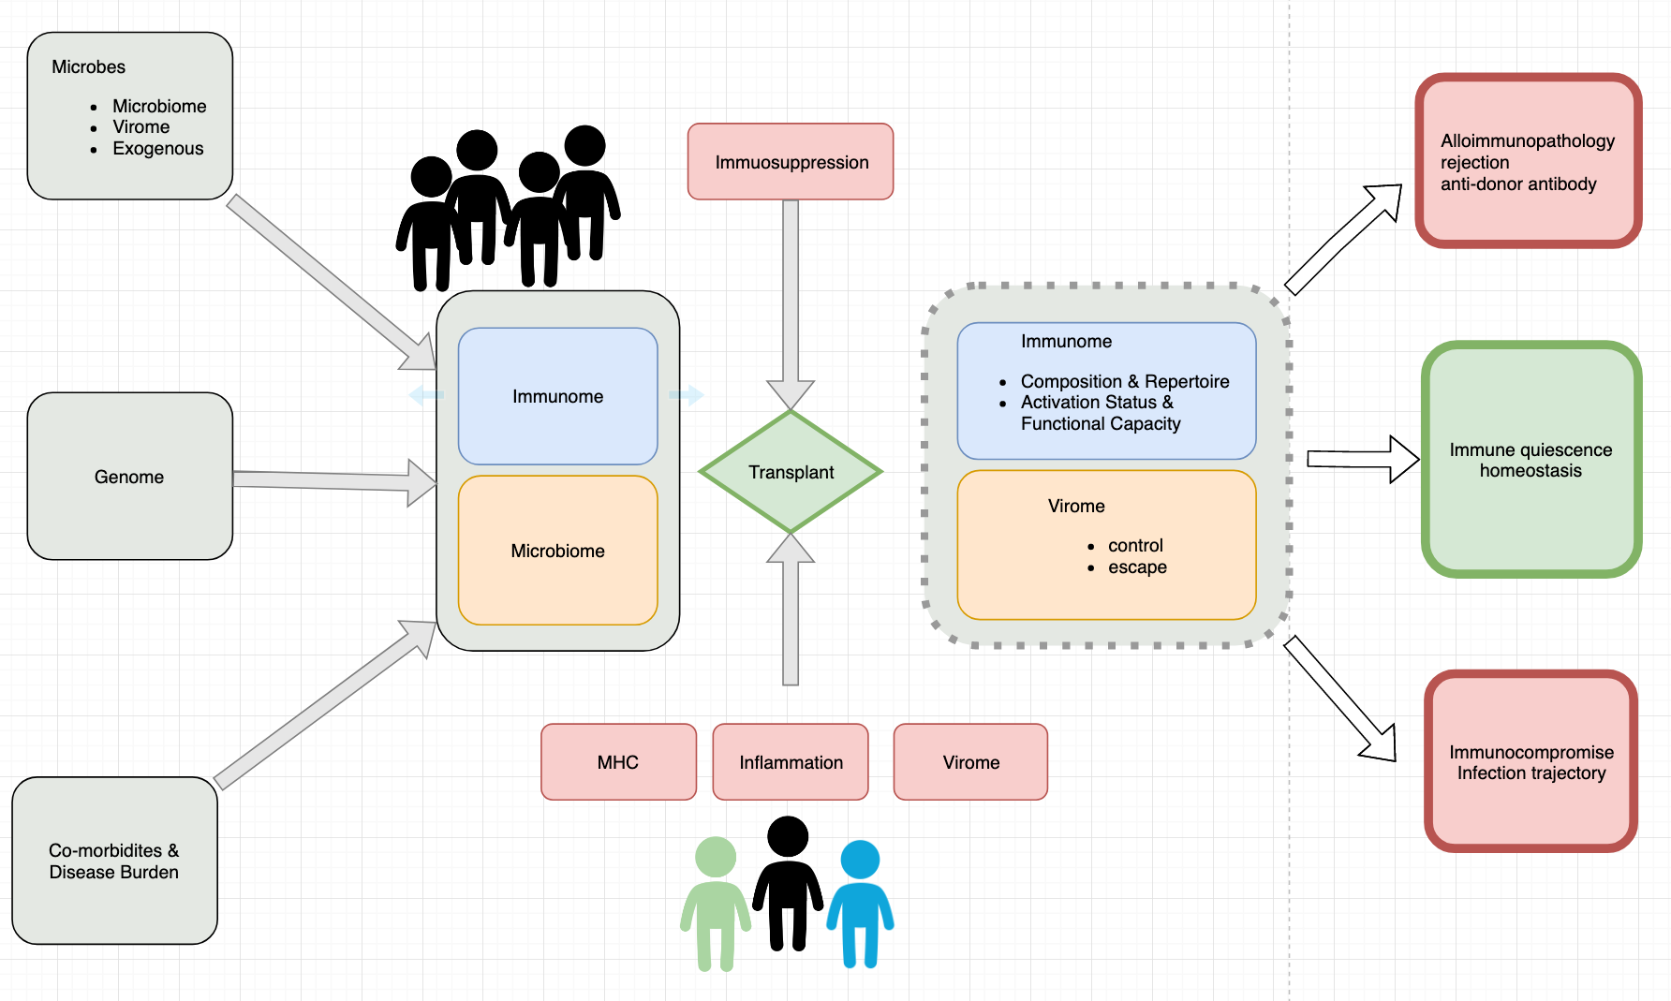
Our emerging perspective of transplant trajectories
One Transplant for Life

Slide 31
Context- Why we do what we do
Project 1 Virus (CMV) infection after transplant
Clinical Data Science
Project 2 Understanding protective immunity to CMV
Systems biology - Single cell immune profiling (multi-omics)
Building our team, our culture, and our ecosystem

Slide 32
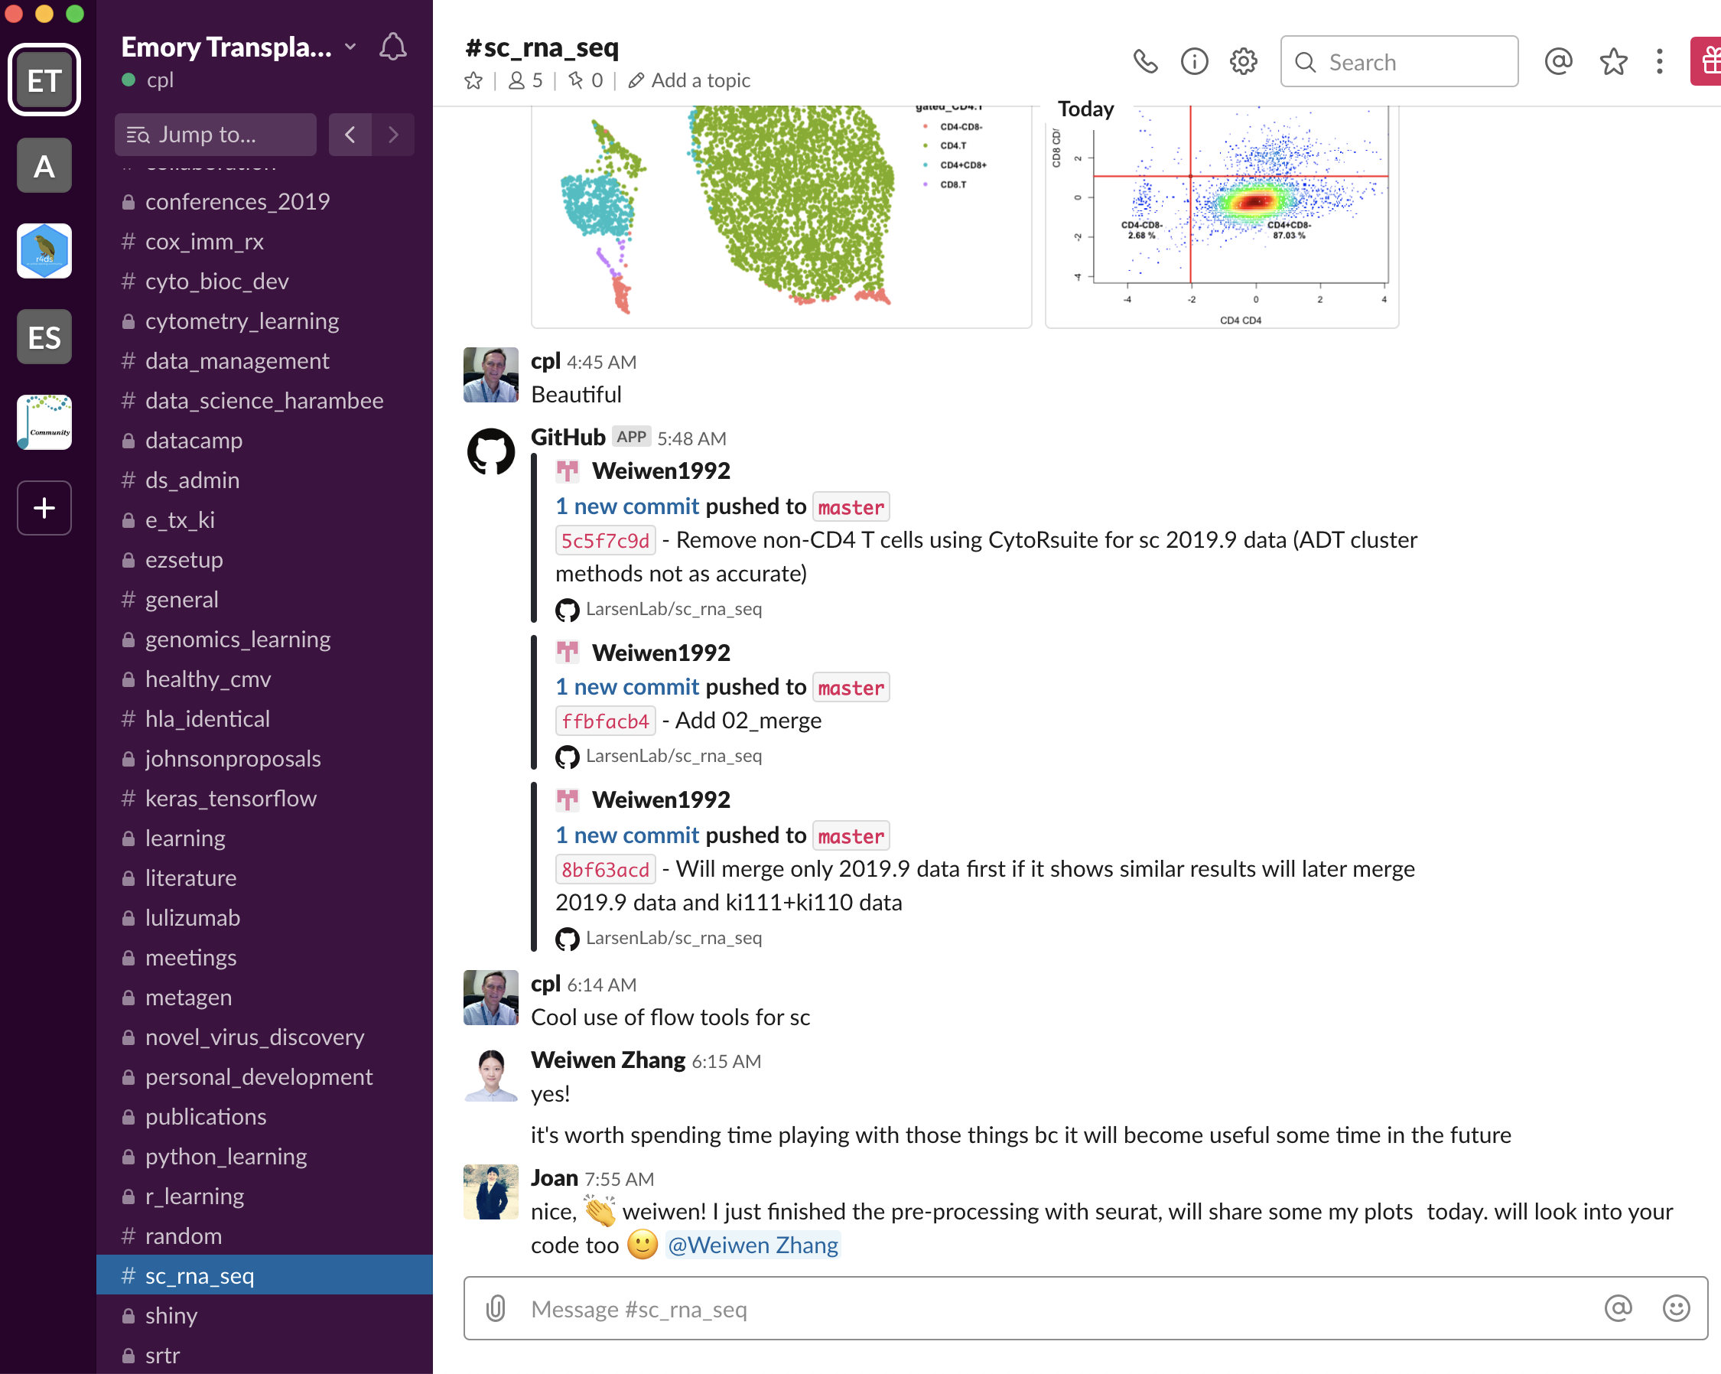
Teamwork and flow
Learn, share, learn some more
Package vignettes
Rmedicine 2018
DCR
Datacamp
RstudioConf – workshop
Bioconductor conf
Slack learning channel

Slide 33
七転八起
Fall down seven times
Rise up eight
Learn, grow, have fun –
Cultivate a joyful mind
Maintain a growth mindset
Failure is a key part of learning
Fail fast if you can
Try not to fail the same way repeatedly
if you do, learn from that too

Slide 34
Special Thanks
The R community
Rmedicine organizers
R Ladies
The Bioconductor community
Joe Rickert
Emily Zabor
Jacki Burros
Roger Peng

